Slide 1
Technology in the Solar Car Challenge
Eric Andrechek, Race Technology Director
Brandon Ching, Special Assistant to Race Director for Teams/Auditing

Slide 2
Current Technology
Scoring & Scrutineering

Slide 3
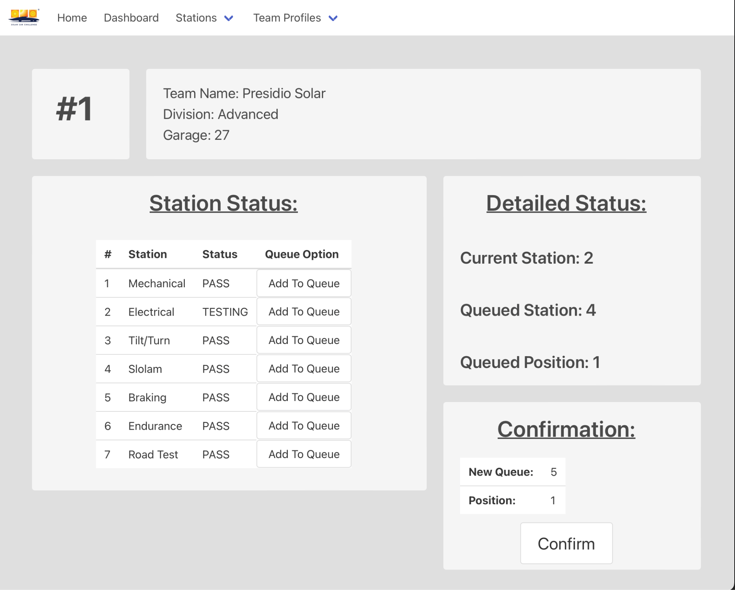
Scrutineering Control
Manage/view station queues
Track team progress
Register team for stations

Slide 4
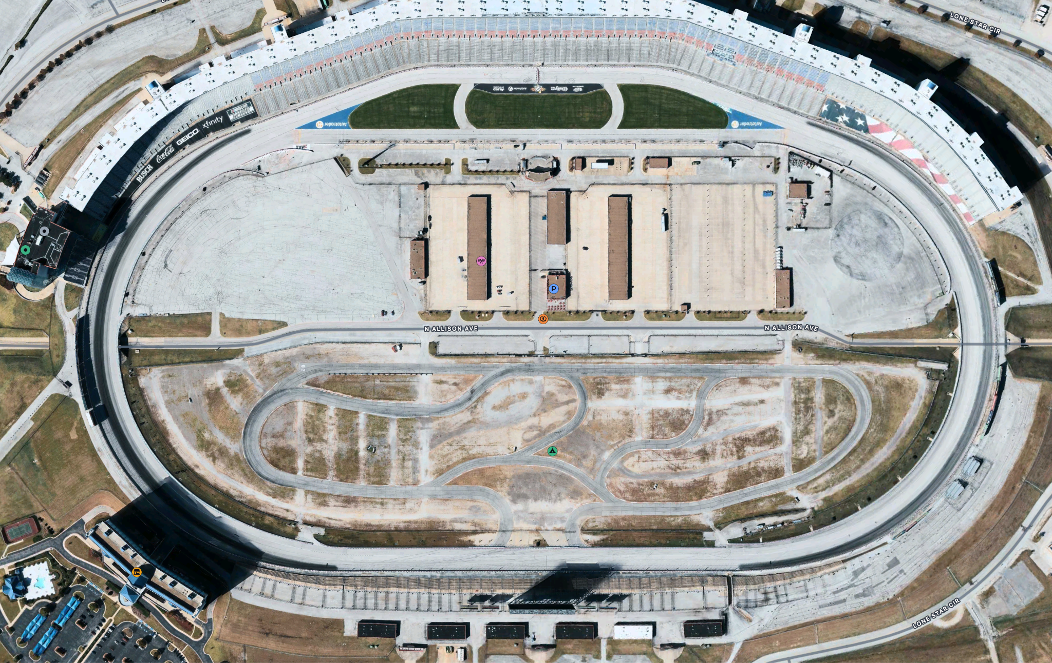

Slide 5
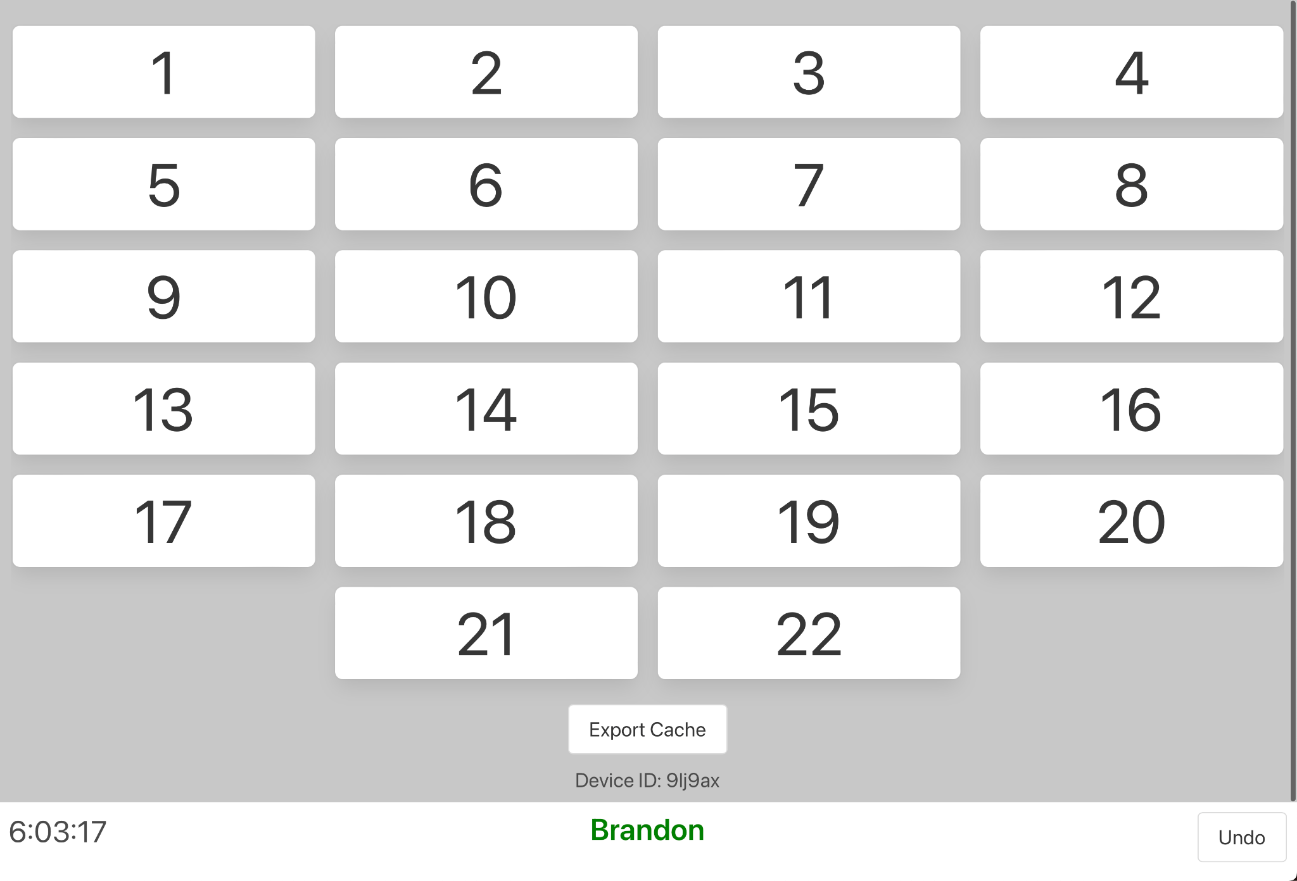
Clickey

Slide 6
A Sneak-Peek Into the Future 👀
Technology in the works at the Solar Car Challenge

Slide 7
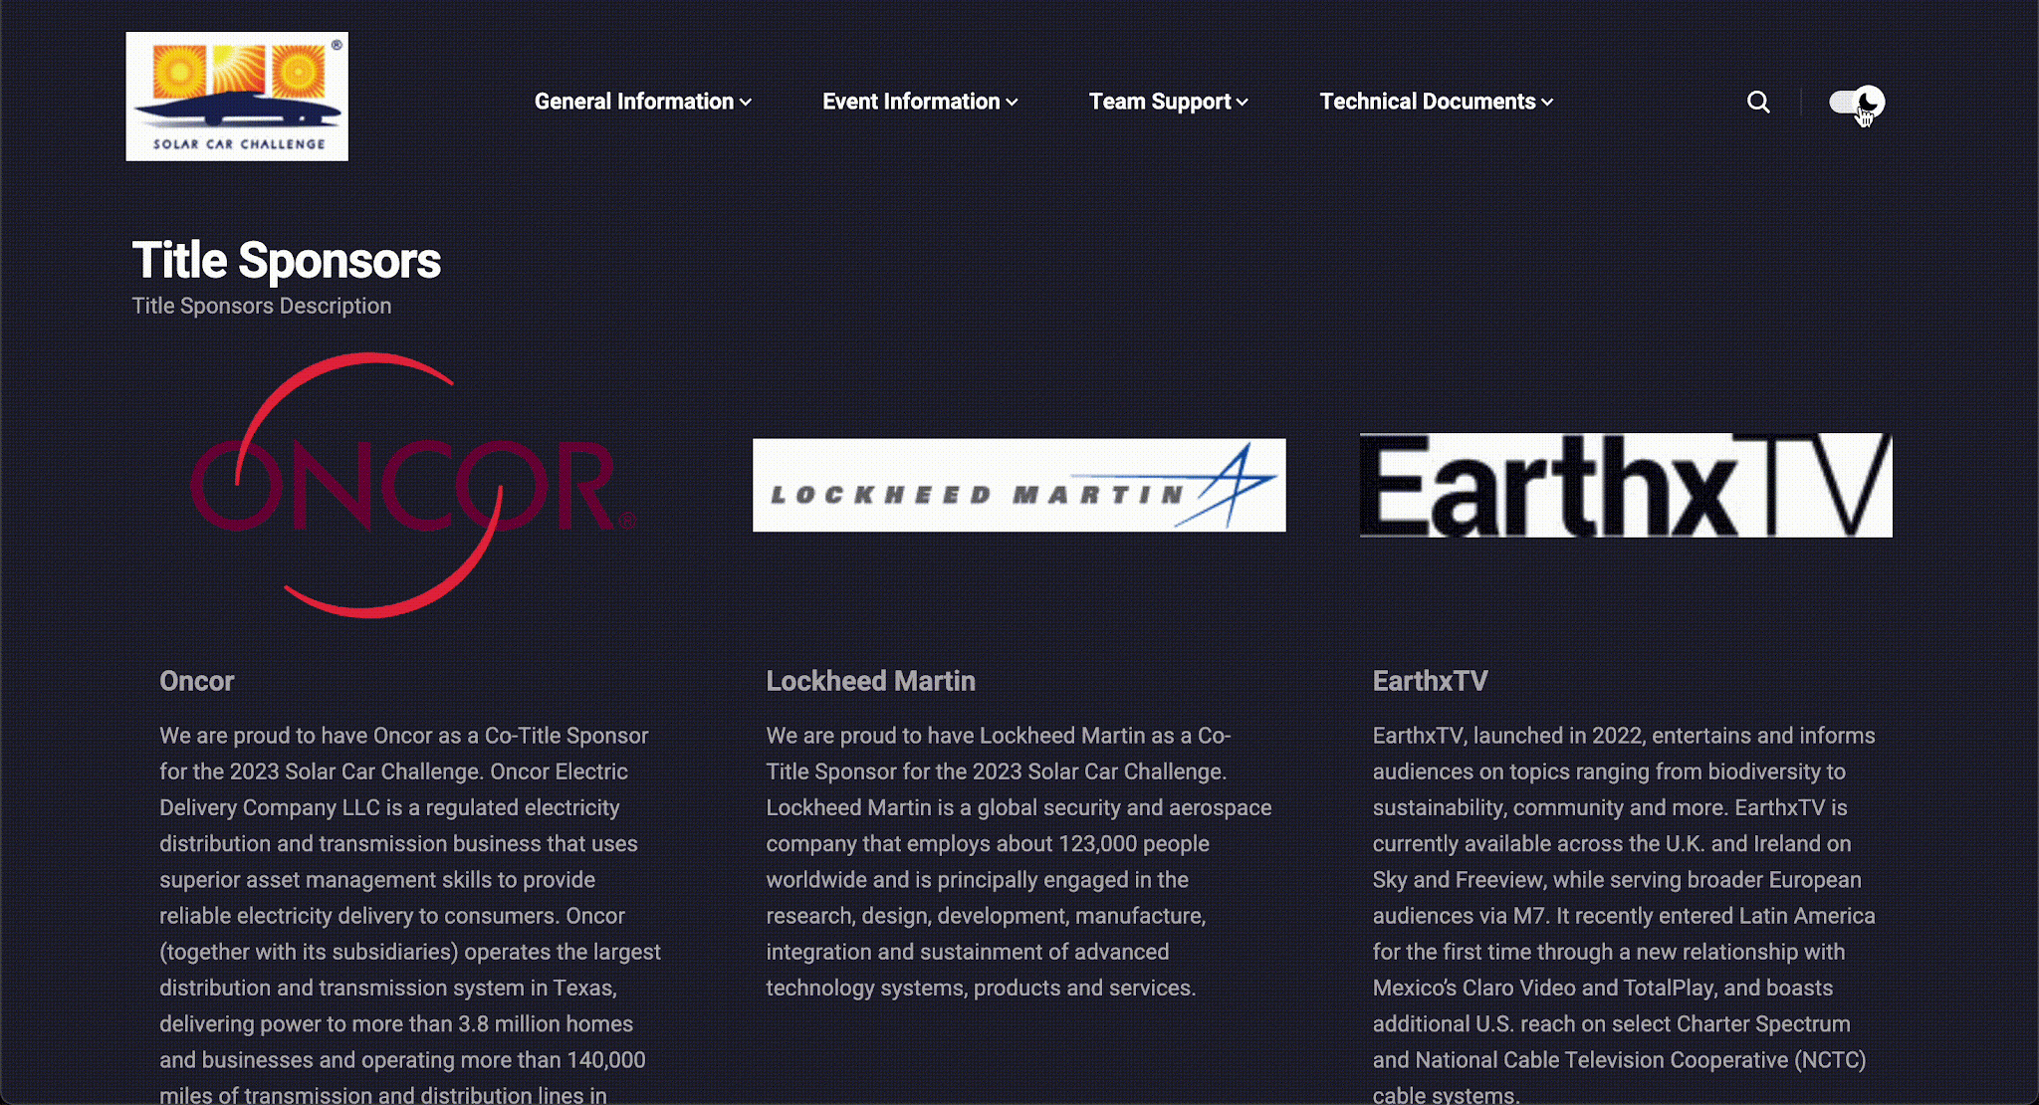
Website Version 2.0
Modern accessibility and web standards
Dark mode
Mobile friendly
Faster page loads
Full resolution image download

Slide 8
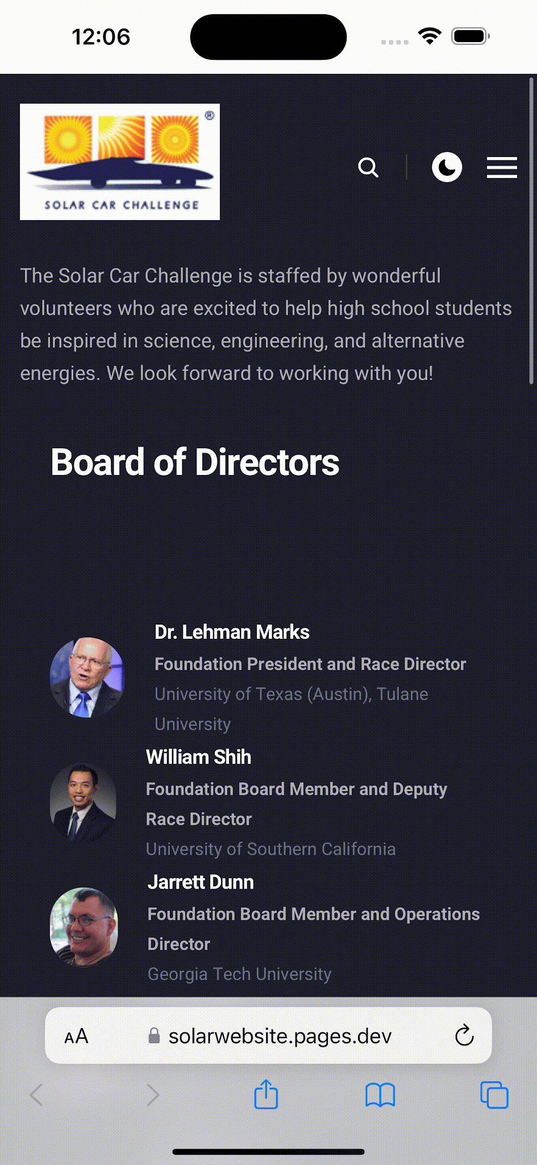
Mobile App
General Goal: Mobile native version of our website + extra features, like:
Push notification updates
Team logins
Scrutineering registration and queuing
Live scores
Judge assignments
Race start orders

Slide 9
Timeline
Beta Release App
July 2024
Announcement
January 2024
*Not to scale
Beta Release Website
June 2024
Public Release Website/App
July 2025
Notes:
#1 Goal is functional, reliable, stable technology to keep the race running!
Website redesign is currently in the works, and in the weeks leading up to the race we will publish it at a different URL so that both websites can be used at the same time while we migrate
We are prioritizing testing our existing systems heavily to ensure their stability during the race, but internally you may see some of the race staff using an app on their phone in addition to the physical paper methods used before
We may have a mobile app beta release ready for teams to experiment with during the race, but it will be a trial run this year and will still require teams to do everything as they have in the past while we ensure it works

Slide 10
Questions? Comments? Concerns?
Eric Andrechek - eric@solarcarchallenge.org
Brandon Ching - brandon@solarcarchallenge.org

